Slide 1
Week 10 - Project Proposal Presentation

Slide 2
Class Operation
Lecturer: Professor Daeryong Lee
Class Operation:
- Class Time & Room : 16:00~19:00(3 Hrs.) Tue, S2-402
- Operation : Lecture(50%), Student Presentation(15%), Practice/Project(35%)
- Student: AI. Big Data Department (2nd year and above)
Evaluation (A 30%, B 40%, C and Under 30%), 3 Credits
- Attendance: 20%
- Assignment: 10%
- Attitude(Tardiness Check): 5%
- Mid-term Exam: 25%
- Project Task: 40%
    Project Proposal Presentation(10%) – per team
    Project Completion Presentation(20%) – per team
    Individual Contribution and Peer Evaluation(10%) – per student
  Contact : lldr12@wsu.ac.kr, lldr12@naver.com , 010-9530-4784
  Office - S2 6th Fl. #106

Slide 3
Class Schedule
Week | Date | Contents
Week 1 | 9/1 | 1. Introduction to Operating Systems
Week 2 | 9/8 | 2. Hardware and Software Concepts
Week 3 | 9/15 | 3. Process Concepts
Week 4 | 9/22 | 4. Thread Concepts
Week 5 | 9/29 | 5. Asynchronous Concurrent Execution
Week 6 | 10/6 | 6. Concurrent Programming 7. Deadlock and Indefinite Postponement
Week 7 | 10/13 | 8. Processor Scheduling 9. Real Memory Organization and Management
Week 8 | 10/20 | 10. Virtual Memory Organization 11. Virtual Memory Management
Week 9 | 10/27 | PBL Class Introduction Mid-Term Exam
Week 10 | 11/3 | Research the Project Make Project Proposal
Week 11 | 11/10 | Present Project Proposal
Week 12 | 11/17 | Project Development
Week 13 | 11/24 | Present Project Progress & Status
Week 14 | 12/1 | Project Development
Week 15 | 12/8 | Project Completion Presentation
Theory Class
PBL Class

Slide 4
Team & Team members
 | Team | ID | Name |  | # | Team | ID | Name
1 |  | 202512451 | Shahi Ramita Kumari |  | 19 |  | 202512398 | Omar Arlan
2 |  | 202512406 | Aruunov Adil Iskhakovich© |  | 20 |  | 202512422 | Chowdhury Tasnuva Ahmad
3 | 1 | 202412155 | Emu Mst Himel Haider |  | 21 | 4 | 202512467 | Mills Madison
4 | Task1 | 202310628 | 이원석 |  | 22 | Task2 | 202212230 | Farhodova Fariza Farkhodovna
5 |  | 202412139 | Naeem Zibrij(NotT) |  | 23 |  | 202512485 | Turatbekov Dilnur
6 |  | 202608432 | Sushanth Kunde |  | 24 |  | 202608427 | Sahsah Adam (H)
7 |  | 202512336 | Panaeva Polina |  | 25 |  | 202512413 | Mojumder Diganta
8 |  | 202412372 | Esonov Sunnatbek Saydulla Ugli |  | 26 |  | 202412428 | Fatima Laraib
9 | 2 | 202512310 | Rajbhandari Kusum |  | 27 | 5 | 202512356 | Kharal Pujan
10 | Task2 | 202512450 | Nurmatov Tynchtykbek© |  | 28 | Task3 | 202412318 | Ngo Thi Ngoc Mai
11 |  | 202512389 | Khan Muhammad Ahmed Murtaza(NotT) |  | 29 |  | 202510023 | Alavee Ahmed(NotT)
12 |  | 202608452 | Singla Vaidant(?) |  | 30 |  | 202608447 | Vashist Pushkal
13 |  | 202512492 | Woudneh Naomi Eskinder
14 |  | 202512390 | Le Huu Duy |  |  |  | 202512428 | Alhama Mhd Feras(?)
15 | 3 | 202412354 | Harneet Kaur |  |  |  | 202210040 | 추경연
16 | Task1 | 202512435 | Yadav Roshan Kumar |  |  |  | 202412409 | Sadi Md Ahsanul Haque
17 |  | 202512538 | Mureithi Alvin Kinyua
18 |  | 202608424 | Denis Mathis Ghislain

Slide 5
Timetable
Today’s Schedule
 | Time | Activity | Comment
1 | 16:00~16:30 | Midterm Result, explain week10 Schedule etc Review Ground Rule and R&R
2 | 16:30~18:00 | Present Project Proposal and Q&A Team 5: 16:30~16:45 Team 4: 17:45~18:00 Team 3: 16:45~17:00 Team 2: 17:00~17:15 Team 1: 17:15~17:30
3 | 18:00~18:20 | Weekly Report (Prepared team first) | Current status What to do next
4 | 18:20~18:30 | Leader Meeting

Slide 6
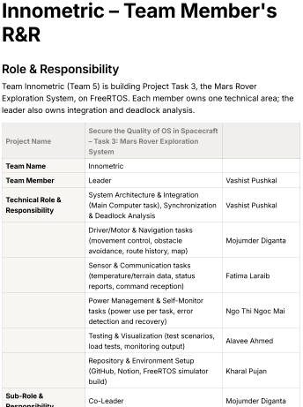
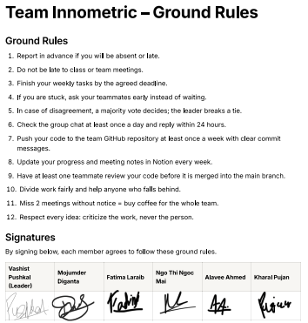

Team Ground Rule and R&R Review - Innometric(Team5)
Excellent – Focus on Action
R&R is assigned very well.
Each member is participating in the R&D.
Good Handwritten Signature

Slide 7
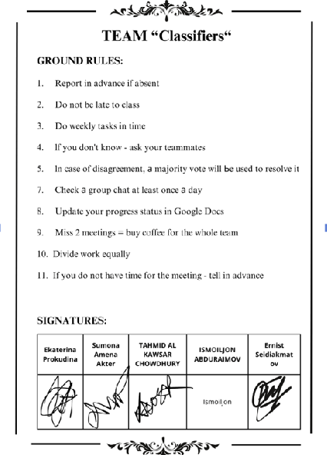
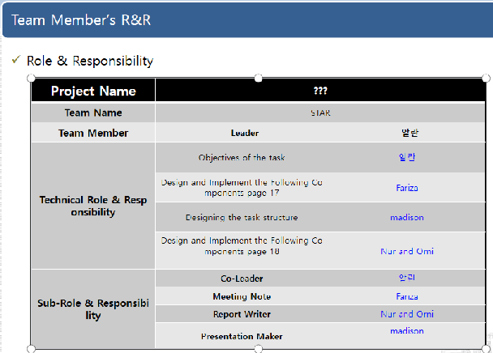
Team Ground Rule and R&R Review - Classifiers (Team4)
Excellent – Simple Ground Rule
R&R is assigned too roughly.
Need more detail
Insert Signature of Your team member

Slide 8
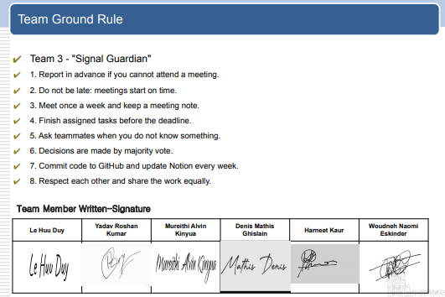
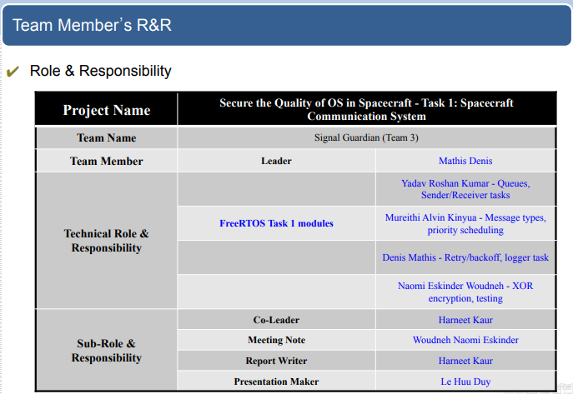
Team Ground Rule and R&R Review - Signal Guardian (Team3)
Excellent – Simple Ground Rule
R&R is assigned too roughly.
Need more detail
Good Handwritten Signature

Slide 9
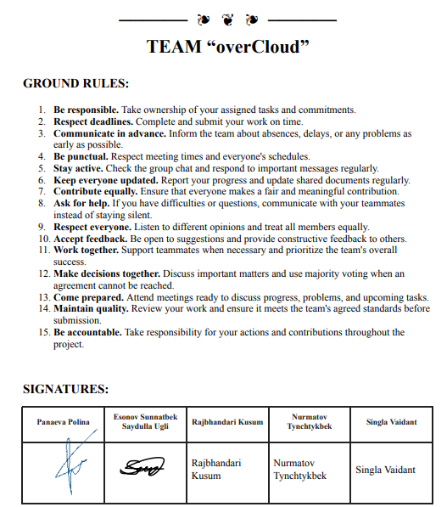
Team Ground Rule and R&R Review - overCloud (Team2)
Excellent -
R & R ?
Handwritten Signature only by some members

Slide 10
Team Ground Rule and R&R Review - Team1

Slide 11
Weekly Report - Use this form
Team Name (Week ?? – Month/Date)
Current Week Status | Next Week Plan
-Wrote LLD and made Software Architecture. . LLD completed (5/20 modules) – 4/13 . Made SW Architecture – 4/10 -Made datasets . Took pictures (200 pictures) – 4/13 - issue: take a long time to get enough pictures . Gathered dataset – 4/13 - list dataset here…….. -Implemented Graphical Interface . Coded (5/10 modules) – 4/10 | - Write LLD . Write LLD (20/20 modules) – 4/27 - Write code . UI (10 modules) – 5/20 . Feature Extraction(15 modules) – 5/10 . Classify Drug(10 modules) – 5/15 - Analyze Dataset . Dataset 1 – 4/23 . Dataset 2 – 4/25 - Get feedback from professor . LLD – 4/21 . Code – 4/21
Sample

Slide 12
It is prohibited to modify and distribute the contents of this material without permission.
All copyrights belong to ‘Life and Power Press - 생능출판사’.

Slide 13
Project Proposal Presentation - Guideline
Project Proposal Presentation – Guideline
  Presentation time : 15 Minutes including Q&A
  Presentation slides : Max. 15 slides
Main Title | Contents
1. Cover Page | Course Name, Project Title, Team name and team member information, Division of roles within the team (Leader / Technical / Documentation, etc.)
2. Project Summary | Define project core issues, Summary of Hypothesis and Resolution Direction, Specify the distinction between technical and learning objectives
3. Background and Problem Description | Background of the problem, Limitations of existing systems or approaches, Interpreting the problem from the operating system perspective
4. Things to Investigate | Matters that require further investigation and verification, Factors of Technical Uncertainty, Areas that require experimentation or analysis
5. Project Constraints | Technical restraints, Time, environment, and tool constraints, Project scope limitations
6. Project Goals | Technical goals, Learning goals, Priorities and success criteria
7. Project Schedule | Step-by-step action plan, Interim inspection timing, Risk factors and response plan
8. References | Official documents, Teaching materials and reference manuals, Papers & technical data

